Slide 1
Forecasting and Classifying Air Quality in NYC: A Data-Driven Approach (1980–2025)
Khandker M Qaiduzzaman

Slide 2
Abstract
In this project, I analyzed the daily Air Quality Index (AQI) data from the New York City counties (Bronx, Kings, New York, Queens, and Richmond). This study solely focused on the air quality dynamics in New York City counties within the timeline 1980 to 2025. These 45 years of historical data helped identify the long-term trends, seasonal cycles, and anomalies in urban air pollution. This project has employed a deep learning time series model to forecast the future AQI values. Additionally, several machine learning classification algorithms have been implemented to classify the AQI categories- Good, Moderate, Unhealthy for Sensitive Groups, Unhealthy, Very Unhealthy, and Hazardous.
This project focused on the most important data science workflows, including the extract, load, and transform (ELT) process, data cleaning, data pre-processing, feature engineering, visualization, exploratory data analysis (EDA), data modeling, and model evaluation. A deep learning model, Long Short-Term Memory (LSTM) networks, was chosen to forecast the future AQI level. The experimental result showed that the LSTM had an MAE score of 8.16, an RMSE score of 11.65, an MAPE score of 28.44% and an R-square score of 0.56, which makes the model decent. For the AQI category classification problem, a comparative analysis was done using Logistic Regression, Random Forest, Light Gradient Boosting Machine (LightGBM), Support Vector Classifier (SVC), and K-Nearest Neighbor (KNN) classifiers. The experimental result showed that tree-based ensemble techniques such as LightGBM and Random Forest performed the best with an F1-score of 59% and 57%, respectively. The non-parametric technique KNN also performed as well as Random Forest (57%). Logistic Regression and SVC underperformed and faced difficulties with complex relationships and class imbalance.

Slide 3
Introduction
Every year, the USA and Canada experience wildfires in summer and fall that affect the air quality. Due to climate change, wildfire seasons are lengthening and becoming more active every year. Additionally, urbanization, industrialization, deforestation, etc., increase air pollution and impose a higher threat to public health.
As a data analyst working in the New York State Department of Health, I found this topic relevant to my industry since environmental pollution increases the public health risk, especially among members of sensitive groups.
In this project, the following research questions have been addressed to better understand air quality of NYC:
What was the Air Quality Index (AQI) trends and seasonal pattern across NYC counties from 1980 to 2025?
Can deep learning time series models forecast future AQI levels accurately?
Can machine learning techniques predict AQI categories (e.g., Good, Moderate, Unhealthy, etc.) using different features?

Slide 4
Tools & Technologies and Project Code
Python 3.13.5
Jupyter Notebook 7.3.2
My SQL Workbench 8.0 CE
Project Code: The python and SQL codes of this project are available here. The link is also provided in reference section [1].

Slide 5
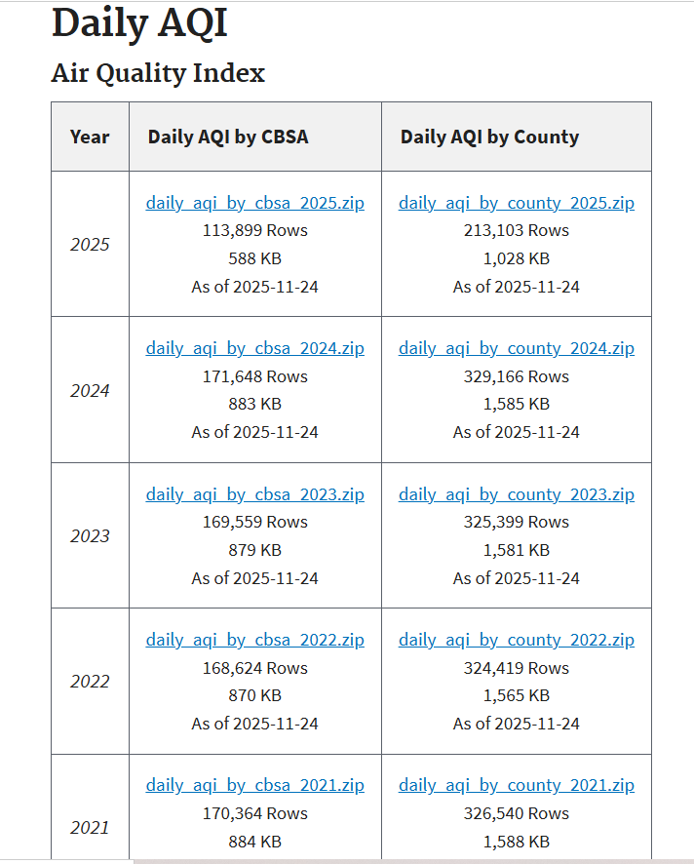
Data Wrangling
Data Collection: The dataset has been collected from the United States Environmental Protection Agency (EPA) website. The pre-generated data files are available in CSV format in the following link:
https://aqs.epa.gov/aqsweb/airdata/download_files.html?file=daily_aqi_by_county_2023.csv.zip#AQI

Slide 6
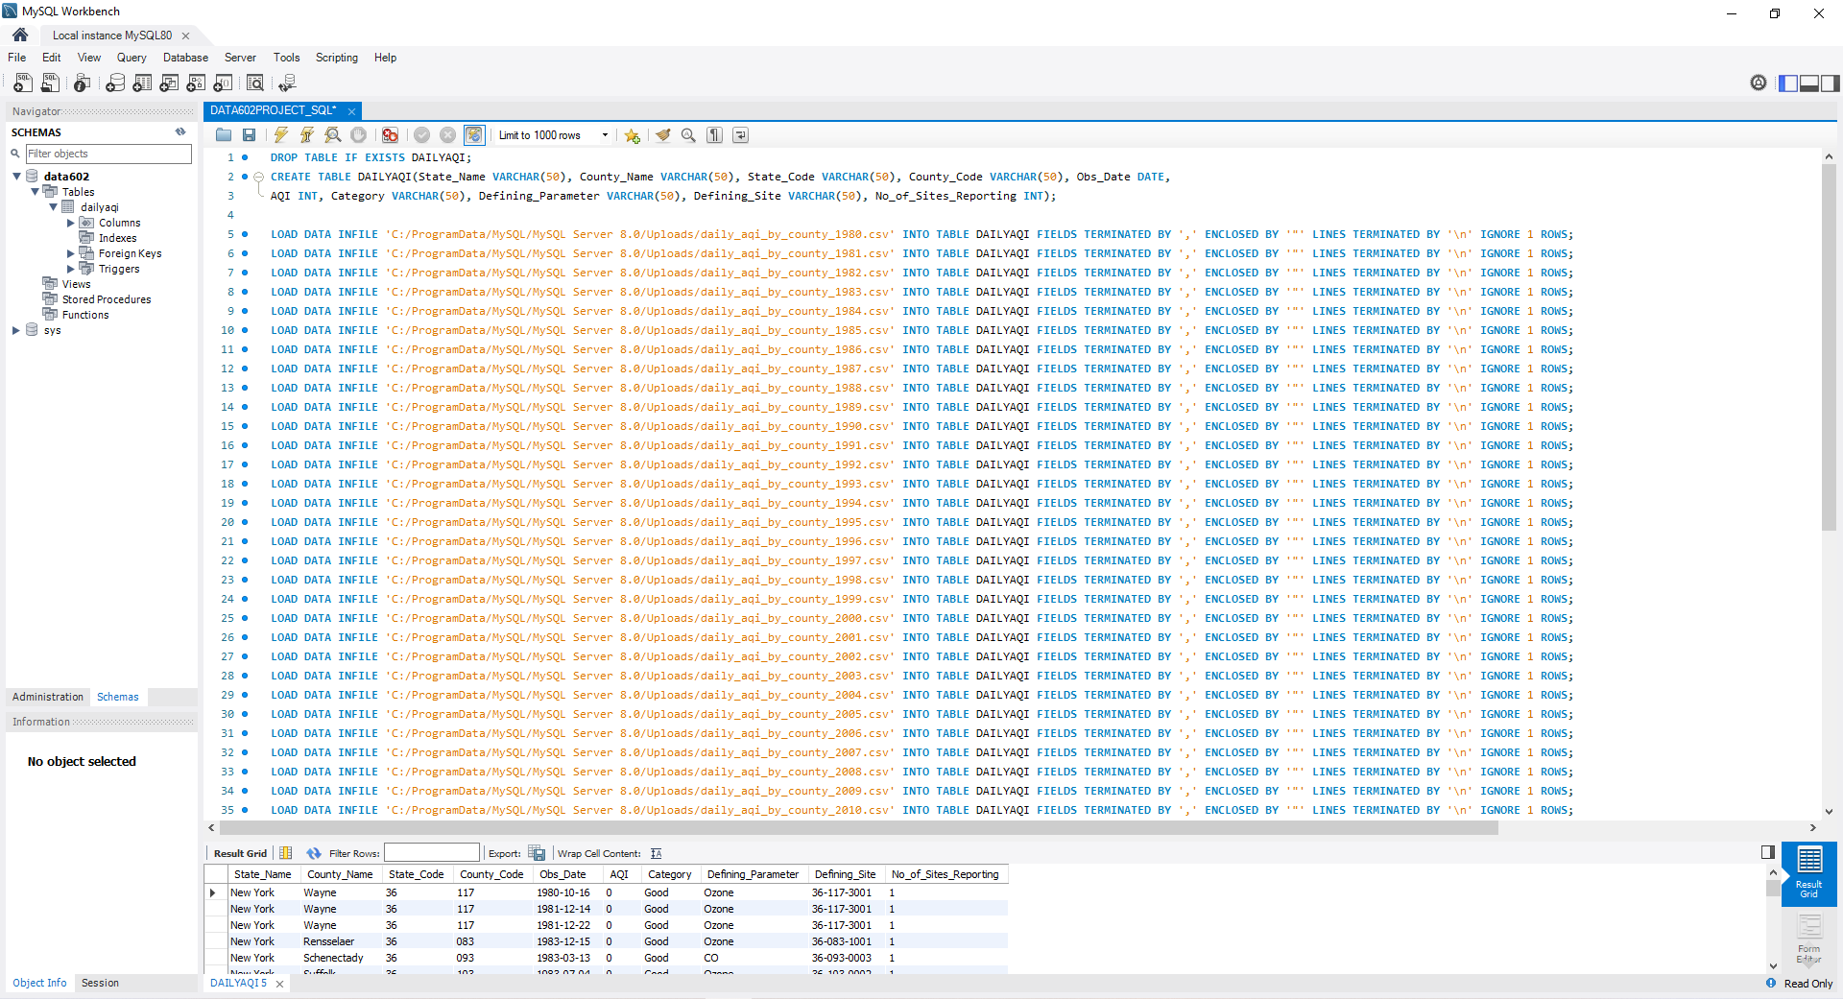
Data Wrangling
ELT Process: Every year the United States Environmental Protection Agency (EPA) publishes the daily AQI data for all states. That is why all the yearly CSV data were inserted in a MySQL database.

Slide 7
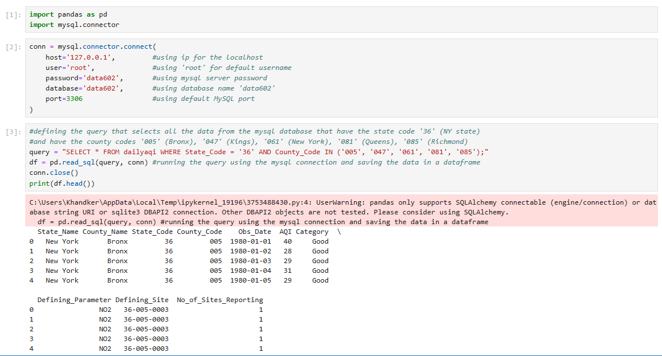
Data Wrangling
ELT Process:
Python’s pandas and mysql.connector library were used to execute the SQL query and load the data into the dataframe.
The SQL query filtered the NY state data from the database and then the data for NYC only using county codes (005, 047, 061, 081, and 085) were inserted into the pandas dataframe.

Slide 8
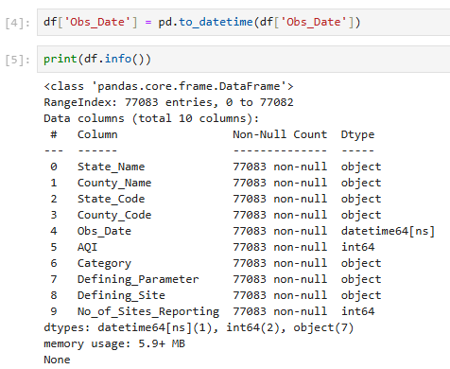
Data Wrangling
Dataframe Information:
The dataframe info shows that there are 77083 instances and 10 columns.
The Non-Null Count shows that there are no null values in this dataset.
The Obs_Date column was converted to Datetime data type.
All the other columns are object/ string type, except No_of_Sites_Reporting- which is integer type.

Slide 9
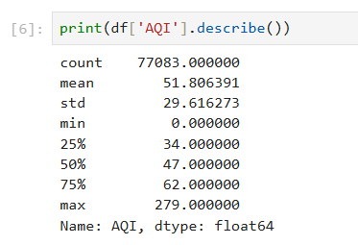
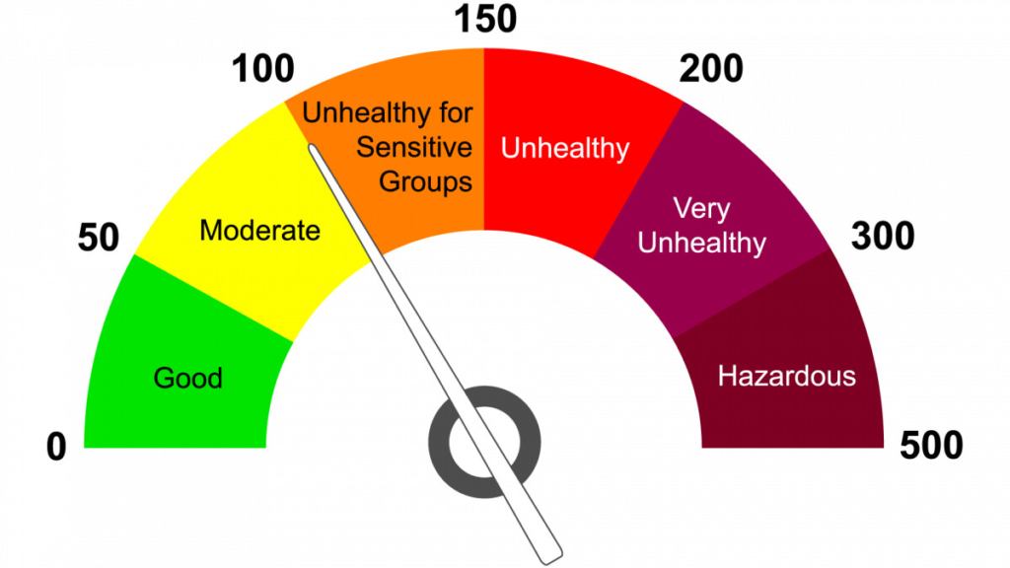
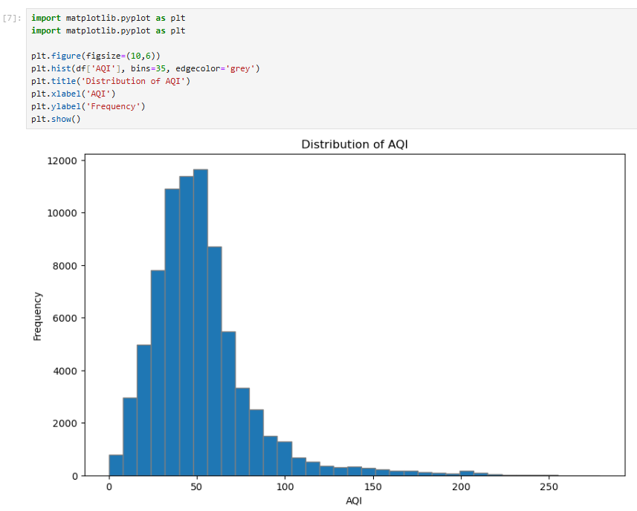
Exploratory Data Analysis
Image taken from internet: https://c4scourses.in/blog/air-quality-index-aqi/?srsltid=AfmBOoo1Wdw36nHB71nLUdb0Vsyd2Dndkhi14htNdO4o3nGwHrYXIfra
Description Statistics and Histogram plot for AQI:
The description statistics for AQI shows that-
The mean AQI value is 51.8 and the maximum value is 289.
That means according to the AQI category definition in https://www.epa.gov/wildfire-smoke-course/communicating-air-quality-conditions-air-quality-index, NYC had on an average “Moderate” (Moderate = 51-100) air quality in last 45 years.
The highest AQI value is recorded 279 in the same period, and it is categorized as “Very Unhealthy”.
Another interesting observation is that there was no “Hazardous” category recorded.
The distribution also shows bell curve with slight right skewness

Slide 10
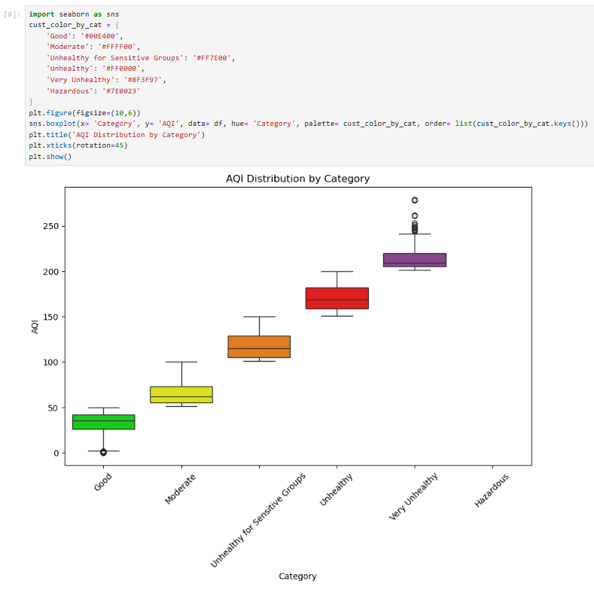
Exploratory Data Analysis
The box plot validates that the data falls within the defined range of the AQI value for each category.
The box plot also shows that for Category “Good” there are some instances for which AQI value is 0.
Also, there are significant number of outliers for the category “Very Unhealthy”.

Slide 11
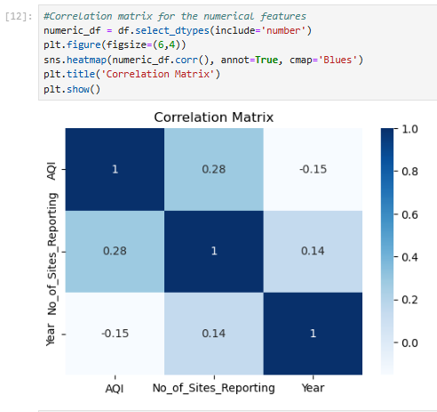
Exploratory Data Analysis
Correlation Matrix for the numerical features:
AQI vs No_of_Sites_Reporting = 0.28. AQI tends to rise somewhat but not significantly as the number of reporting locations rises.
AQI vs Year = -0.15. AQI tends to decline very slightly over time.
No_of_Sites_Reporting vs Year = 0.14. Number of reporting sites seems to rise slightly over time.

Slide 12
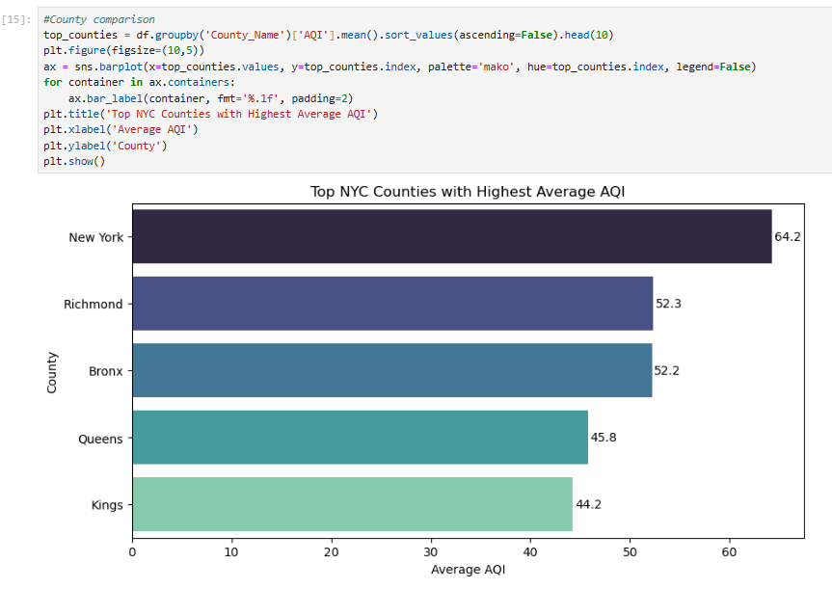
Exploratory Data Analysis
County comparison for average AQI (1980-2025):
The barchart shows that New York county has the highest average AQI value 64.2.
Richmond and Bronx have almost identical average AQI.
Kings has the lowest AQI value 44.2, followed by Queens (45.8).

Slide 13
Research Question 1
What was the Air Quality Index (AQI) trends and seasonal pattern across NYC counties from 1980 to 2025?

Slide 14
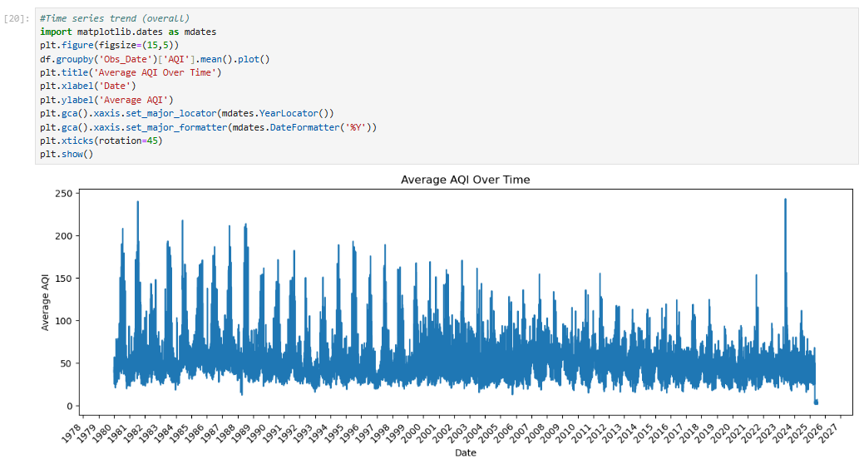
Overall Time Series Trend by Daily Average AQI
A time series plot of daily average AQI of NYC shows high spikes above 150.
The overall variability has slightly reduced over the year.
However, the recurring spikes remains- potentially due to some seasonal causes such as summer ozone levels, wildfire smokes, winter heating emissions etc.
Another notable spike is seen in 2023 that was over 200, could be linked to wildfire events in Canada. This is further evident from New York State Department Of Health’s report found here: https://www.health.state.ny.us/press/releases/2023/2023-08-24_study_asthma_related_er_visits.htm.
This seasonal pattern also suggests careful consideration while applying machine learning techniques.

Slide 15
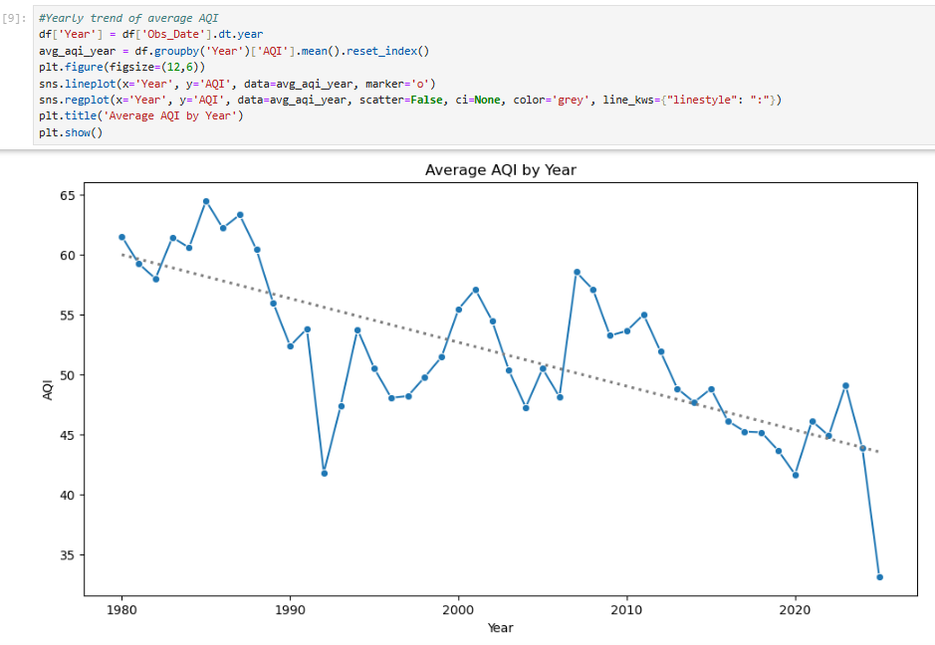
Yearly Trend of Average AQI
The line plot illustrates how the average AQI has changed over the year in NYC.
In general, the line shows a downward trend with some occasional spikes and falls.
In this timespan, the highest average AQI in NYC was recorded in 1985, and the lowest was recorded in 1992 (the average AQI for 2025 seems lower, but that is due to incomplete year data).
In recent years, the air quality index has been consistently below 50, which is further confirmed in the IQAIR’s analysis, found here: https://www.iqair.com/us/usa/new-york/new-york

Slide 16
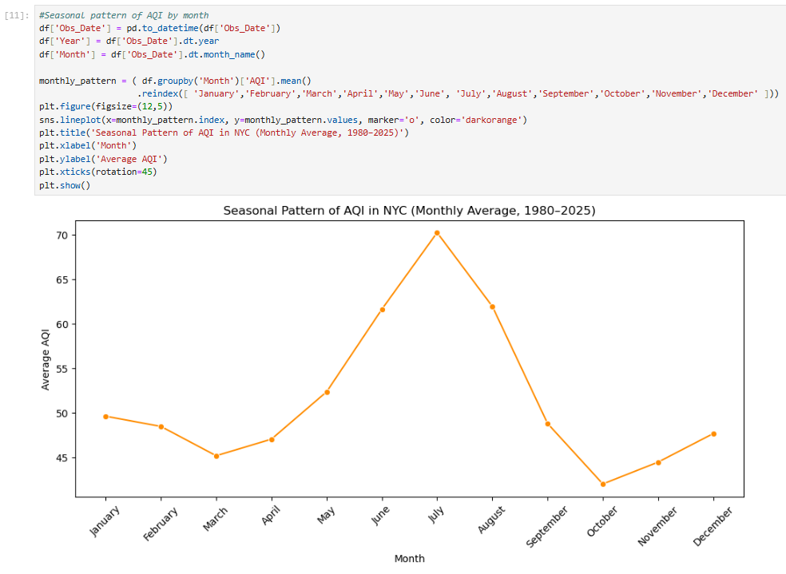
Seasonal Pattern of Average AQI by Month
Winter months (November - February) usually have moderate AQI levels, indicating stable air quality
In the early spring, the AQI values slightly declines reaching a local minimum in March
AQI level starts increasing from April and peaking in July, showing the worst average AQI of the year- probably driven by higher temperatures, increased ozone formation and wildfires
The AQI level drops drastically through August and September, touching the bottom with lowest AQI of the year in October

Slide 17
Research Question 2
Can deep learning time series models forecast future AQI levels accurately?

Slide 18
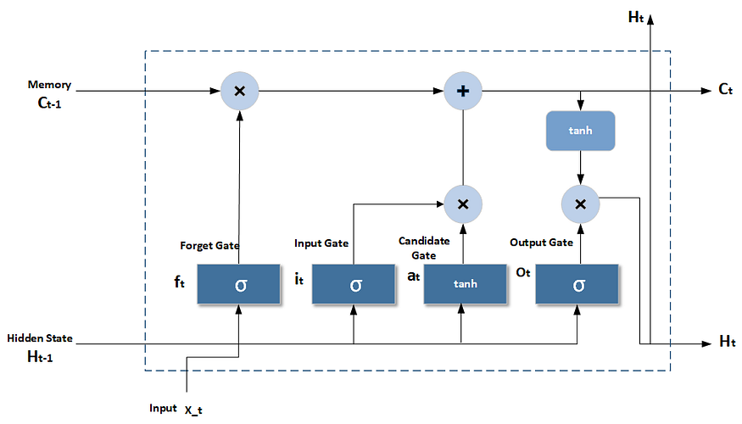
Long Short-Term Memory (LSTM)
Long Short-Term Memory (LSTM) is a kind of recurrent neural network (RNN) created to manage sequential data and understand temporal dependencies.
Conventional RNNs are built to process sequential data by preserving a hidden state that retains information from earlier time points. Nonetheless, they face challenges with long-term dependencies because of:
Disappearing Gradients: Throughout backpropagation, gradients may reduce exponentially, hindering the network's ability to learn long-range relationships.
Exploding Gradients: On the other hand, gradients may increase exponentially, leading to numerical instability.
LSTMs address these problems by incorporating a memory cell and gating mechanisms that regulate information flow, enabling the network to efficiently preserve and revise its memory over time [2].

Slide 19
Why LSTM is Appropriate for AQI Forecasting
Grasps Time-Based Relations: LSTM can identify trends across time, making it suitable for time series such as AQI.
Manages Extended Trends: In contrast to basic RNNs, LSTM retains information for extended durations, which is beneficial for seasonal or annual AQI trends.
Resilient to Incomplete Data: LSTM is capable of handling inconsistencies in measurement intervals typical in environmental data.
Non-linear Connections: AQI relies on various interacting elements (climate, emissions, etc.), which LSTM can model proficiently.
Adaptive Forecasting: LSTM can revise forecasts with incoming data, enabling dynamic AQI predictions [3].

Slide 20
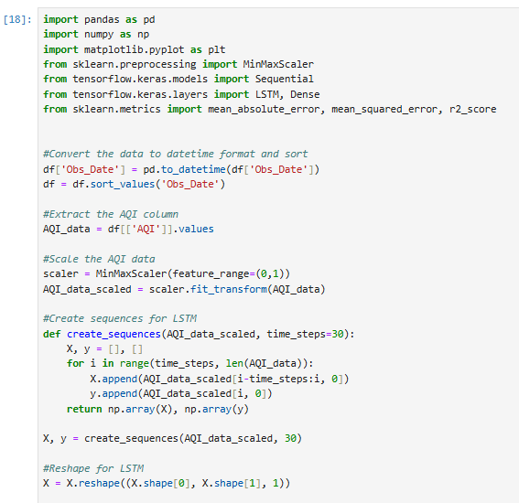
Data Pre-processing for LSTM Model
Date-time conversion: Change the 'Obs_Date' column to datetime format and arrange the dataframe in chronological order.
AQI column extraction: Choose the 'AQI' column and transform it into a NumPy array for analysis.
AQI data scaling: Scale the AQI values to a 0–1 range to enhance LSTM training.
LSTM sequence creation: Create sliding windows of the previous 30 AQI values as input features and use the subsequent value as the target for LSTM.
Data reshaping: Reshape the input data to 3D format [samples, time_steps, features] required by LSTM layers.

Slide 21
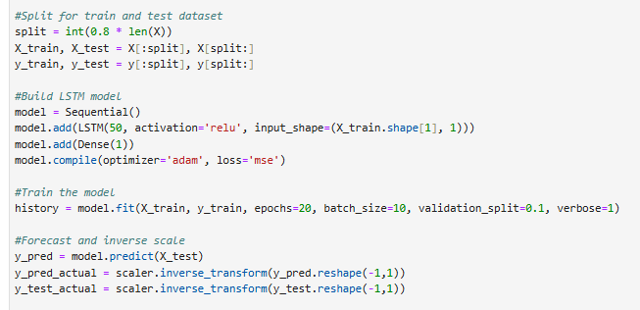
Build LSTM Model, Train and Predict
Split train and test data: The dataset is divided into training (80%) and testing (20%) sets
Build LSTM model: The model employs a single LSTM layer containing 50 units, succeeded by a Dense output layer to forecast the subsequent AQI value.
Train the model: The model utilizes the Adam (Adaptive Moment Estimation) optimizer alongside the mean squared error (MSE) loss function for training. Training is conducted for 20 epochs with a batch size of 10, and a segment of the training data is utilized for validation.
Forecast the AQI value: The trained LSTM model produces AQI predictions for the test dataset.
Inverse the scale: AQI values are converted back to their original scale by applying the inverse of the normalization process

Slide 22
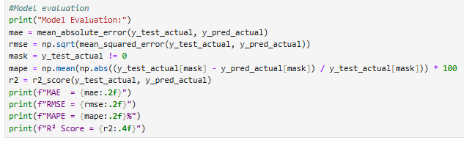
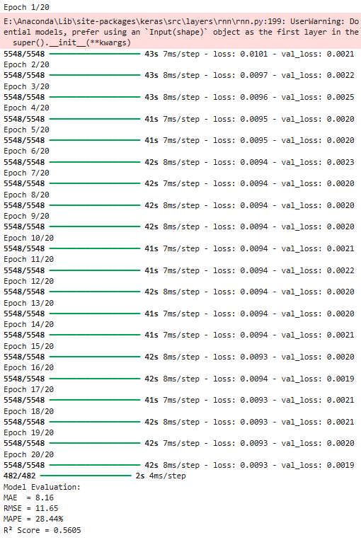
LSTM Model Evaluation
The effectiveness of the LSTM model is assessed by analyzing predicted AQI values in relation to actual observed values through various metrics.
Mean Absolute Error (MAE): An MAE of 8.16 indicates that, on average, the model's AQI predictions differ from the actual values by roughly 8 AQI units, which is acceptable for environmental forecasting where AQI values frequently vary significantly.
Root Mean Square Error (RMSE): The RMSE of 11.65 shows that significant prediction errors are quite restricted. Given that RMSE is just slightly greater than MAE, it indicates that significant prediction errors are uncommon, implying consistent model performance.
Mean Absolute Percentage Error (MAPE): A MAPE of 28.44% indicates a moderate relative error, frequently observed in AQI forecasting because of abrupt pollution surges driven by weather conditions and emissions. This indicates that the model identifies overarching trends instead of temporary irregularities.
R² Value: An R² value of 0.56 suggests that the model accounts for nearly 56% of the variability in AQI values. This illustrates substantial predictive capability for a complicated, noisy environmental time series.

Slide 23
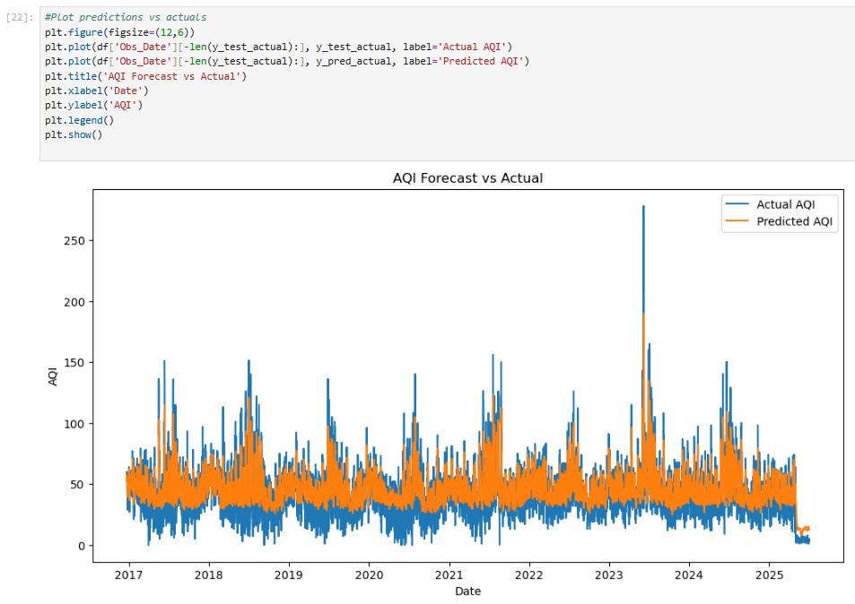
Model Accuracy, Limitations and Future Improvements
Model accuracy:
The LSTM model demonstrates consistent learning, with training and validation losses reducing simultaneously and staying near each other during training.
This suggests solid generalization and no signs of overfitting.
The obtained MAE (~8.2) and R² (~0.56) indicate that the model identifies significant temporal trends in AQI data, establishing it as a dependable baseline for forecasting
Limitations and future improvements:
The model indicates mild underfitting, exhibiting an early performance plateau and leaving some AQI variability unaccounted for.
This could be a result of a basic single-layer LSTM and restricted input characteristics.
Performance may be enhanced by incorporating meteorological variables, increasing model complexity, or employing more sophisticated architectures
Figure: plot of predicted AQI values vs actual AQI values

Slide 24
Research Question 3
Can machine learning techniques predict AQI categories (e.g., Good, Moderate, Unhealthy, etc.) using different features?

Slide 25
Algorithms for AQI Category Classification
In this project, five classification algorithms have been used to classify the AQI categories- Good, Moderate, Unhealthy for Sensitive Groups, Unhealthy, Very Unhealthy, and Hazardous without using the AQI values.
Logistic Regression:
A linear model that forecasts probabilities for distinct categories employing a logistic function.
Random Forest:
A collection of decision trees that enhances accuracy through the averaging of various tree predictions.
Light Gradient Boosting Machine:
A fast gradient boosting algorithm that grows trees leaf-wise to reduce errors from previous trees and handle large datasets efficiently.
KNN (K-Nearest Neighbors):
A non-parametric technique that categorizes based on the predominant class among nearby neighbors.
SVC (Support Vector Classifier):
Identifies the best hyperplane that distinguishes classes and can represent non-linear boundaries using kernels

Slide 26
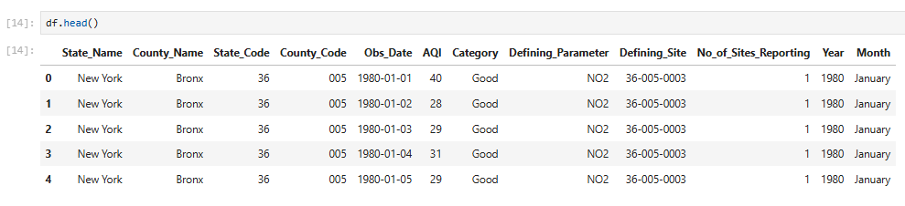
Relevant Features
State_Name: not used; this data is for New York only
County_Name: not used; identical to County_Code
State_Code: not used ; this data is for New York only
County_Code: used; as categorical variable
Obs_Date: not used; only year and month is extracted and used
AQI: not used; not relevant to this research
Category: not used; target variable
Defining_Parameter : Used; as categorical variable
Defining_Site: not used; it’s the site ID that has very low variance, closely tied to County_Code and will not add much information. Also, may cause overfitting.
No_of_Sites_Reporting: used; as numerical variable
Year: used; as categorical variable (avoid false numerical assumption)
Month: used; as categorical variable

Slide 27
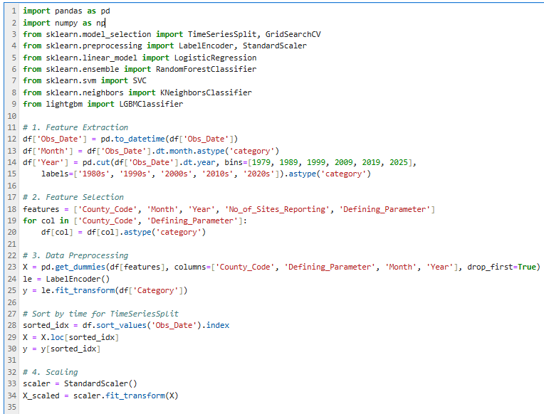
Feature Engineering AND Data Pre-processing
Feature extraction: Month, and Year was extracted from the Obs_Date and converted to categorical variable. Also, Year was grouped in ten-year bins.
Feature selection: County_Code and Defining_Parameter feature were converted to categorical variable and added with Year, Month, No_of_Sites_Reporting to feature list.
Data pre-processing: one-hot encoding input features and the target column Category is converted to numeric form for machine learning algorithms. A sorting is done to preserve temporal order.
Scaling: This step standardizes features to zero mean and unit variance so that scale-sensitive models can learn effectively.

Slide 28
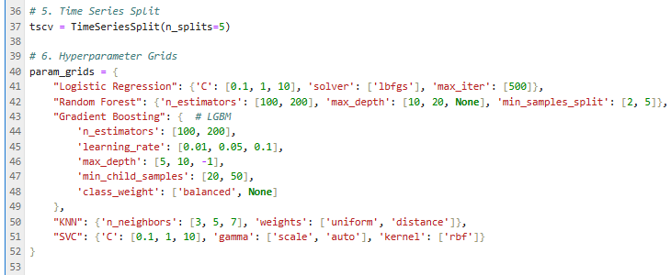
Time Series Split and Hyperparameter Grids
Time series split: Utilizes forward-chaining cross-validation to maintain temporal sequence and avoid data leakage during the assessment of time-dependent models
Hyperparameter Grids: Establishes organized search spaces for every model to methodically adjust crucial parameters and enhance performance in cross-validation

Slide 29
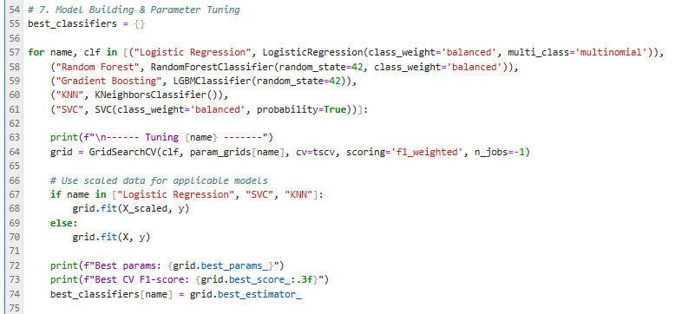
Model Building and Parameter Tuning
Model Building & Parameter Tuning: This part trains several classification models and conducts hyperparameter tuning through GridSearchCV, utilizing time-series cross-validation. For every algorithm, it looks for the optimal parameter combination focused on weighted F1-score, implements scaling only when necessary, and preserves the highest-performing model for the final assessment

Slide 30
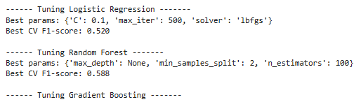
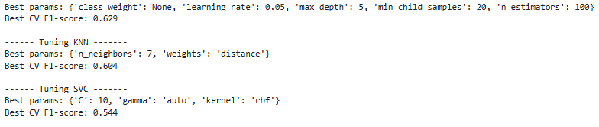
Training (Cross-Validation) Performance
Average weighted F1-score across the TimeSeriesSplit folds for the best parameters.

Slide 31
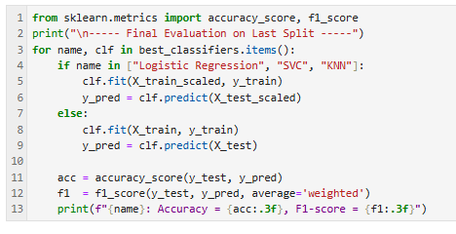


Test (Forecasting) Performance
Model Evaluation: This phase retrains every optimized model within the final time-oriented training period and assesses it during the latest hold-out segment, guaranteeing that the performance mirrors actual future prediction scenarios while maintaining temporal sequence

Slide 32
Model Comparison by Accuracy and F1 Score
Classifier | F1 Score | Accuracy
LightGBM | 0.59 | 0.58
KNN | 0.57 | 0.55
Random Forest | 0.57 | 0.53
SVC | 0.42 | 0.37
Logistic Regression | 0.33 | 0.35
LightGBM showed the highest performance with Precision: 0.581 and F1-measure: 0.588. Optimal equilibrium between precision and recall within AQI categories
KNN and Random Forest demonstrated comparable effectiveness. Better at capturing non-linear patterns compared to linear models.
Logistic Regression and SVC exhibited subpar performance. Faced difficulties with intricate connections and unequal class distribution.

Slide 33
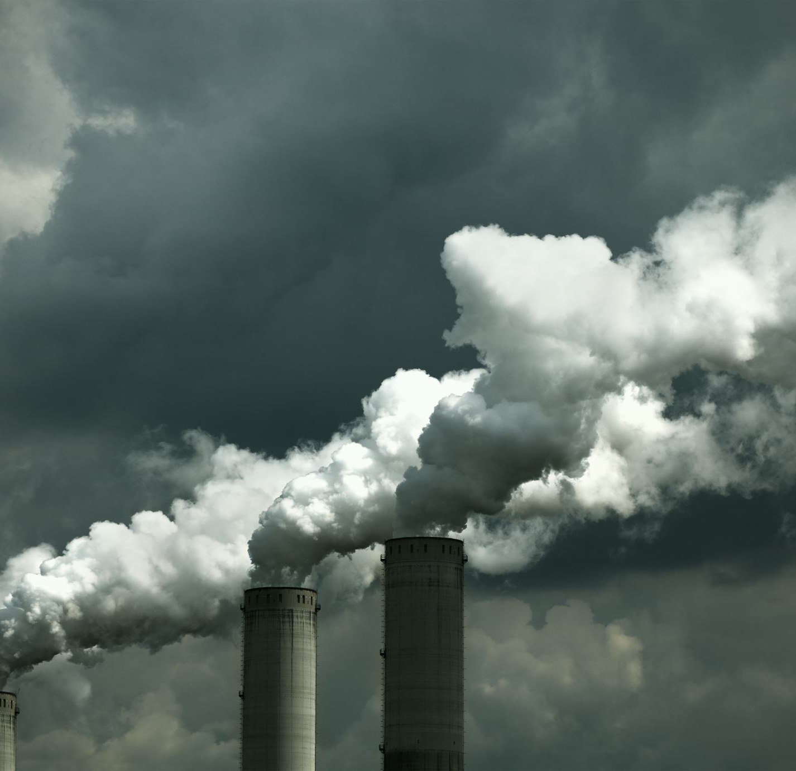
Limitations and Future Improvements
Limitations:
Moderate overall results (F1 < 0.6) suggest that classifying AQI continues to be difficult.
Class imbalance impacts infrequent yet important AQI categories.
Absent external factors (e.g., climate, pollution, congestion)
Future Improvements:
Integrate weather-related factors (temperature, wind, humidity).
Utilize sophisticated imbalance management techniques (SMOTE, focal loss)
Investigate probabilistic forecasting for AQI alerts that account for uncertainty

Slide 34

Conclusion
AQI Trends and Seasonal Variations (1980–2025): Examination of air quality in NYC showed distinct seasonal and temporal trends, with elevated pollution levels during certain months and ongoing variations between counties, validating that AQI fluctuates both seasonally and regionally.
Predicting Future AQI Values Using Deep Learning: LSTM time series models showed encouraging results in forecasting future AQI trends, successfully capturing temporal relationships and seasonal fluctuations more effectively.
Forecasting AQI Classifications using Machine Learning: Of the classifiers evaluated, LightGBM, KNN, and Random Forest demonstrated the best predictive performance, attaining F1-scores of approximately 57–59%. They excelled in typical AQI categories but faced challenges with infrequent extreme categories because of class imbalance. Less complex models such as Logistic Regression and SVC demonstrated reduced accuracy and F1-scores, underscoring the benefits of tree-based ensemble methods for this objective

Slide 35
References
[1] NafeesKhandker. (2025). GitHub - NafeesKhandker/Forecasting-and-Classifying-Air-Quality-in-NYC-A-Data-Driven-Approach---1980-2025. GitHub. https://github.com/NafeesKhandker/Forecasting-and-Classifying-Air-Quality-in-NYC-A-Data-Driven-Approach---1980-2025
‌[2] Amin, S. (2024, October 11). Part I: Understanding Long Short-Term Memory (LSTM): LSTM Implementation from Scratch. Medium. https://medium.com/@samina.amin/understanding-lstms-lstm-implementation-from-scratch-18965a150eca
[3] Li, Y., Lin, Z., Jin, J., & Kong, D. (2025). Air quality prediction model based on BP neural network and LSTM. Highlights in Science, Engineering and Technology, 141, 147–155. https://doi.org/10.54097/6wv97t44

Slide 36
Thank you!

